Slide 1


SASEWG Systems Approach to Safety of the Environment
3rd Meeting 19th October 2022

Slide 2
Agenda
Sarah Carrington’s Inputs
MOD ASEMS and POEMS
Guidance Document Suggested ToC
Other Next Steps actions outcomes

Slide 3
Contributions
See separate Word document, https://scsc.uk/file/ge/SASEWG-1433.docx
See the York institute: https://www.york.ac.uk/yesi/people/leadership-team/
Cranfield: https://www.cranfield.ac.uk/courses/short/defence-and-security/environmental-management-project-oriented-environmental-management-systems-poems
CAT: https://cat.org.uk/about-us/people/

Slide 4
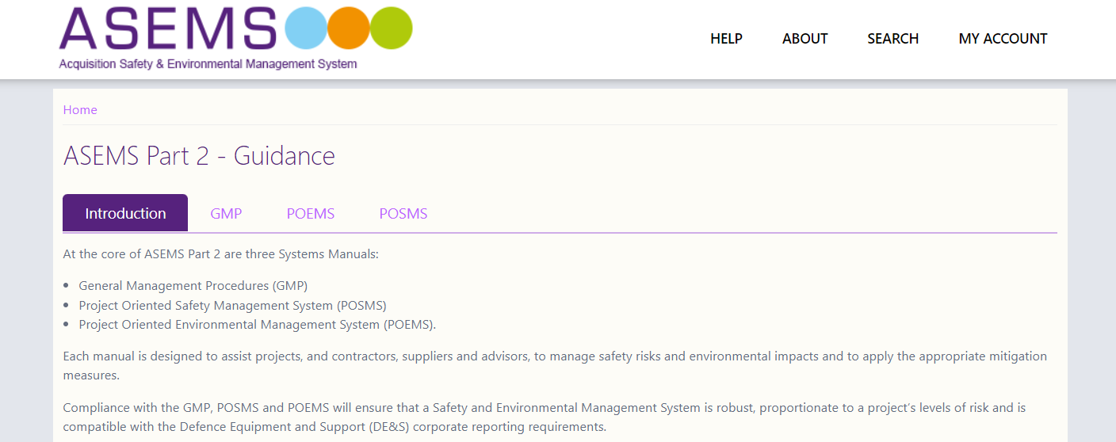
MOD ASEMS
https://www.asems.mod.uk/guidance

Slide 5
A Safety and Environmental Case represents a structured argument, supported by a body of evidence that provides a compelling, comprehensible and valid case that the infrastructure, equipment, platform or service is safe for a given application in a given operating environment.
A safety and environmental argument links the available evidence to the claims made regarding the safety and environmental performance of the Products, Systems or Services and should be both compelling and supported by sufficient evidence. The safety and environmental argument should be articulated in a way that is proportionate to the complexity of the Products, Systems or Services and the level of risk.
ASEMS Safety and Environmental Cases/Assessments

Slide 6
A Safety and Environmental Case should provide evidence that:
The infrastructure, equipment, platform or service operating context and its environment has been accurately captured;
Safety and environmental requirements have been met;
Hazards have been adequately identified and analysed and the associated risk has been assessed in an appropriate manner;
All hazards and potential accidents have had controls applied, to ensure all residual risk has been reduced to a level that is As Low As Reasonably Practicable (ALARP);
Environmental impacts are eliminated or reduced, and positive impacts maximised so far as is reasonably practicable;
The system complies with all relevant safety and environmental legislation, Defence Regulations and MOD Policy;
All measures have been taken to ensure that acceptable levels of safety risk and environmental impacts can be maintained through life.
ASEMS Safety and Environmental Cases/Assessments

Slide 7
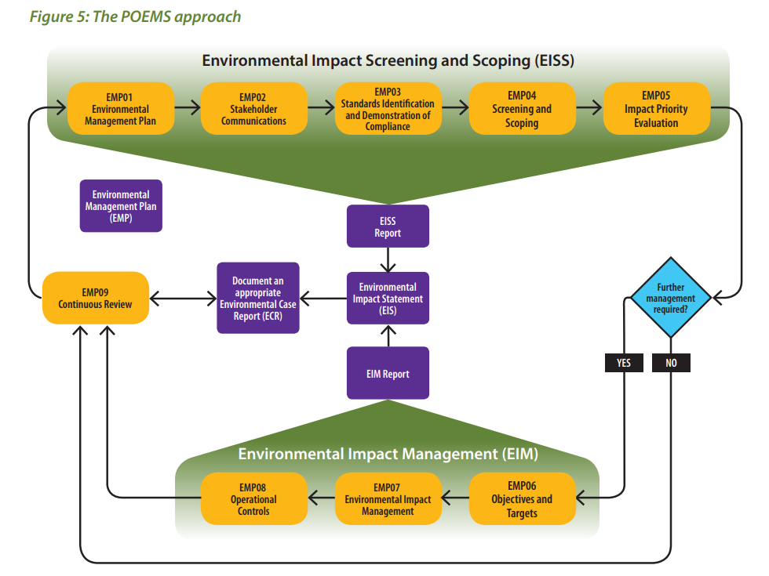
MOD POEMS
https://assets.publishing.service.gov.uk/government/uploads/system/uploads/attachment_data/file/904191/QSEP_Greenbook_Issue_4_FINAL_Lighter_green_cover.pdf

Slide 8
Guidance Document Suggested ToC - 1
Introduction
Mission Statement
Rationale
Statement of Problem
Differences with traditional system safety
Applicability
Definitions
Intended Audience
Existing Work
MOD, UK, EU, ISO, etc.
Risk Assessment Approaches
Evaluation Schemes
Boundaries
Coverage (Impacts, Impacted groups, etc)
Accumulation / Aggregation of harms
Contribution to wider harms
Unknowns
Categories of Events: Black Swan, Perfect Storm, Dragon Kings, etc
Dark Consequences, etc
Emergent Behaviours
Improvements & Enhancements
SASEWG Guidance V1

Slide 9
Guidance Document Suggested ToC - 2
Analyses
Models
Adaptation of existing analyses (FMEA, FTA, FRAM, etc)
New analyses
Tools / Techniques
Supporting Data
Proportionality (have to know when to stop)
Step-by-Step Methodologies
New systems
Lifecycles
Changes to systems
Lifecycles
Additions
Removal and Disposal
Changes to Context
Trade-Off Approaches & Techniques
Principles and Weightings
Included / Excluded
Limits
Business Case Inputs
Obsolecence vs. efficiency
SASEWG Guidance V1

Slide 10
Guidance Document Suggested ToC - 3
Other Factors
Local and Cultural Sensitivities
National/International Dimensions
Legal & Compliance Aspects
Moral and Ethical Considerations
Personal Accountability & Justifications
Making Justifications
Introduction
Argument pattern templates
Systems Approach Environmental Safety Case (SAESC)
Systems Approach Environmental Safety Case Report (SAESCR)
Feed through into SMS/EMS
Reviewing & Auditing
Risk-based & Cover Systems Aspects
Examples / Case Studies
Relationship to Other Work / Standards
Further Work
SASEWG Guidance V1

Slide 11
Mission Statement
“To produce clear guidance on how engineered systems should be developed and managed throughout their entire lifecycle so as to preserve, protect and enhance the environment”

Slide 12
Statement of the Problem
It is acknowledged that systems have been a contributing factor in major accidents to date (Deep Water Horizon, Bhopal, etc).
It is thought that the impact of systems is not currently sufficiently addressed in current environmental safety management practices and standards, which tend to be prescriptive and regulation-based
Knock-on effects and emergent behaviours of systems and eco-systems are not currently assessed and managed properly
There could be benefit in introducing systems thinking, tools and techniques to specifically manage environmental risks due to systems
There are clear business and societal benefits, and wider environmental benefits, in terms of reduced harm, reduced liabilities and improved business efficiencies, in improved management of systems risk related to safety of the environment
Current commercial and legal penalties do not appear to mitigate environmental risk (e.g. dumping of sewage after recent heavy rains)
It is postulated that a safety case type of approach with claims and arguments might be more appropriate than a rules-and-regulations type approach

Slide 13
Audience
Are we aiming at regulators?
Suggest must include:
Developers of systems
Managers (and Commercial) of development projects
Operators / maintenance
Procurers
Government/Local Government
Environmental Groups
Those potentially impacted by the system?
[Note would Grenfell Tower be a good example?]

Slide 14
Applicability - Categories of Systems
Fixed ‘assets’
Mobile systems
Systems moved to different environments (which were not envisaged)
(e.g. shipping can move dangerous organisms from one part of the world to another)

Slide 15
Need Evaluation Scheme
Has to weigh-up short-term and long-term
Have to trade proximity (those near a plant v.s those far away)
Acid rain good example of shifting pain
It might be worth looking at Crossrail for examples. They have a "Learning Legacy" website, which includes environmental themes: https://learninglegacy.crossrail.co.uk/learning-legacy-themes/environment/
Need to trade different negatives (impacts against different receptors) [Environmental Aspects]
Should avoid anyone having an increased risk profile

Slide 16
National/Cultural Issues
Local sensitivities
Historical sites
National/Cultural/Religious issues
Cultural awareness across nationalities

Slide 17
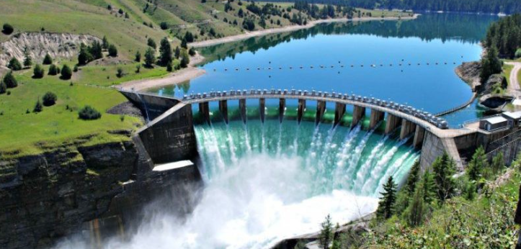

Why are we doing this?
There are some real and important differences between systems safety in a traditional specific safety sector (aviation, rail, etc.)
Idea is to apply Systems Safety approach to systems which are embedded within the natural environment
We are focussing on harm to the environment, which has a wider and more-encompassing basis then traditional safety engineering

Slide 18

Some Differences with Standard Safety Engineering - 1
Harm may be long-lasting and difficult to assess; there may be likely a longer time frame for harm to materialise – Harm Not Immediately Obvious
Systems have potentially wide scope and with more affected parties (for instance pollution in the ocean due to shipping) – Potentially Broader Boundaries
There can be more interactions and relationships between elements (and stakeholders) – Increased Complexity
Systems may have less well-defined and 'leaky' boundaries – Ambiguity of Scope
There may be many competing demands with stakeholders from commercial, governmental, national, local, campaign groups, NGO and individuals – Multiple Stakeholders

Slide 19
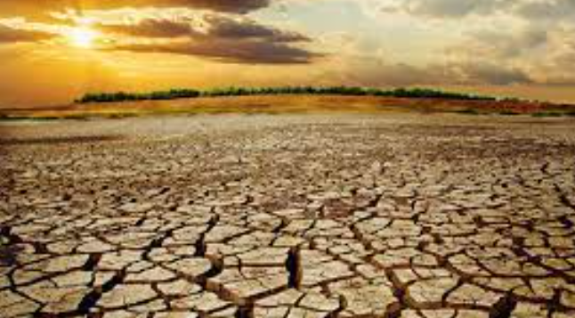
Some Differences with Standard Safety Engineering - 2
There may be an implicit or explicit weighing of benefits (e.g. economic) and losses – Trade-offs Exist Across Multiple Aspects – also at what time a change should be made to minimise environmental impact
There are more unknowns and ‘Dark Consequences’, i.e. we don’t know what the effect will be in the future, particularly on human health - Unknowns
Cumulative effects and combinations can be significant which normal risk assessment doesn’t tend to cover. ‘Ecological Ceilings’. – Long-Term Aggregation of Harms
There are business, legal and ethical issues to be considered, e.g. shipping domestic waste to Turkey. – Wider Societal Aspects
Existing methods for environmental safety tend to be more regulation and compliance-based – Current Focus on Regulation

Slide 20
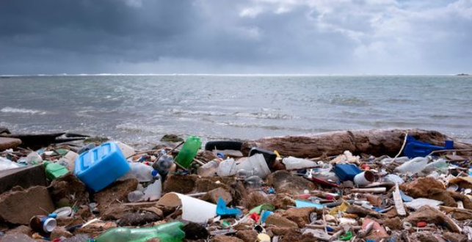
Some Differences with Standard Safety Engineering - 3
Systems of systems approach needed; take a whole systems view - Need to be 'holistic’
Factor in a long-term cumulative approach: ‘My one plastic straw is not a problem…’ – Need to Consider Short, Medium, Long-Term
Include emergent behaviours, chains of events and knock-on effects – Wider Set of Effects
Include management of balance of eco-system; Consider restoration of eco-system ‘opportunity management’ – Aim to Improve/Restore
Aim to improve the overall environmental picture for humans so including mental health, wellbeing, etc. - Wider Scope
Need to be aware of ‘tipping points’ (Dragon King Events), e.g. population gets too small to be viable – Complexity of Natural Systems
Note system may be working perfectly but still have environmental impact
Note culture of not being blamed / not being found out is dominant
Insurance can also play a part
Net-Zero could have a longer-term impact
Need to ascertain point at which should change to new better system with less impact (viable change)

Slide 21
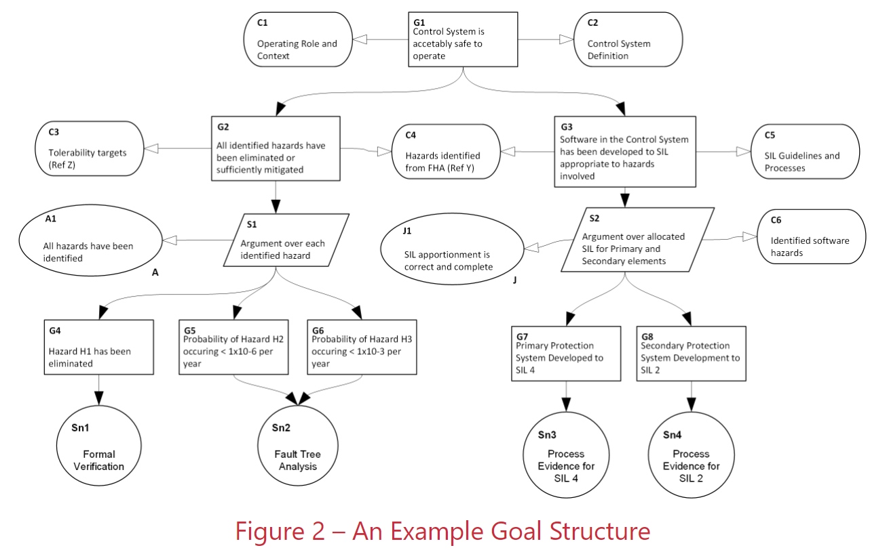
Approach of SASEWG
Introduce the use of our toolbox: safety analyses, formal assurance, safety case paradigm, etc.
Need to consider risk models such as Black Swans, Grey Swans, Perfect Storms (things combining together), Dragon King events, etc. as these may be appropriate
Clearly need to survey before introduction of new system into a context
Need stick like ALARP, but not the same
Awareness of legal implications is useful
Produce new guidance to improve the situation
Can feed into other SCSC groups to influence direction

Slide 22
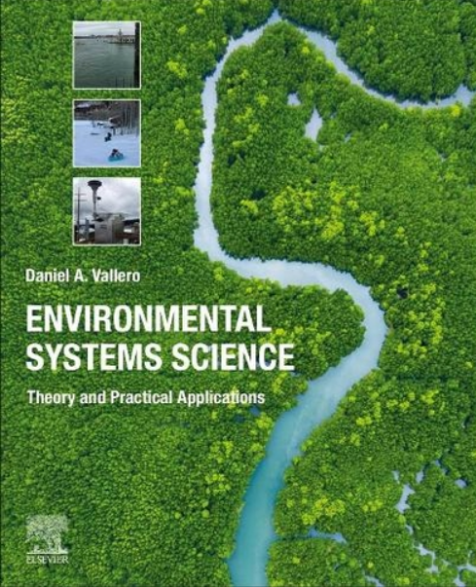

Next steps…
A logo or symbol to represent the group [Earth type] – Suggest system overlaid on planet Earth - Done
A mission/scoping statement [See slide] - OK for now
Some case studies [Some well known, some close to home: wind turbine, autonomous vehicles, Grenfell, Buncefield, aviation – commercial aircraft working as intended but causing environmental damage; commercial space tourist flights]
Could look at introduction of HS2 as example
Study MOD POEMS (https://www.asems.mod.uk/guidance/poems) also ISO 14001->evolved
See if there is any work from UK government (e.g. Environment Agency) that could be useful, https://www.gov.uk/government/publications/environmental-booklet-green-booklet
Review other materials (EU, UN, etc.)
Need new or extended tools, techniques, analyses
Awareness and/or publicity function
A schedule for meetings
Need guidance document ToC to drive efforts and interest
Who do we target guidance at – see new slide

Slide 23
Analyses
Analyses need to cover temporal element (ie. now, +1 year, + 10 years, etc
Need to cover wider impacts (local area, national, international)
Factor-in special sensitivities
Allow for significant uncertainties (emergent and social behaviours)

Slide 24
Next Meeting
Next meeting 16:00-17:30 mid-Oct avoiding half-term

Slide 25
Attendees
Richard Garrett, SQEP
Sarah Carrington, University of York
Mike Parsons, AAIP
James Inge, MOD

